Slide 1


Aynur Aytekin
September 2022

Slide 2
Executive Summary
Introduction
Methodology
Results
Conclusion
Appendix
Outline

Slide 3

Executive Summary
Summary of Methodologies
Data collection
Data wrangling
Exploratory Data Analysis with SQL
Exploratory Data Analysis with Visualization
Interactive Visual Analytics Folium
Machine Learning Prediction
Summary of All Results
Exploratory Data Analysis Results
Interactive Visual Analytics Results
Predictive Analytics Results

Slide 4
Introduction
Founded in 2002 by Elon Musk, Space Exploration Technologies Corporation (SpaceX) has been the most successful spacecraft manufacturer, space launch provider, and a satellite communications corporation of the history. The primary objective of SpaceX is to provide low-cost space transportation which will enable colonization of Mars in the near future.
One of the biggest achievements of SpaceX is Falcon 9, a two-stage rocket. Falcon 9 has a very unique design since the first stage of the rocket is reusable. The average cost of Falcon 9 launch is 62 million dollars, whereas other providers cost about 165 million dollars for each launch.
The goal of this project is accurately predict if the Falcon 9 first stage will land successfully. With this data, we can estimate the cost of the launch. This information can be used if an alternate company wants to bid against SpaceX for a rocket launch.

Slide 5

Section 1

Slide 6
Methodology
Executive Summary
Data collection methodology:
Data was collected using the SpaceX REST API and WEB scraping from Wikipedia.
Data wrangling:
The data collected from API is in JSON format. We used json_normalize function to turn it into dataframe. Using the Python BeatifulSoup package, we web scraped some HTML tables that contain Falcon 9 launch records. For further analysis, we converted those tables into Pandas dataframe. The data was filtered so that only the parts related to Falcon 9 remains. The NULL data was replaced with the mean of the PayLoadMass to take care of the missing data.

Slide 7
Methodology
Executive Summary
Exploratory data analysis (EDA) using visualization and SQL
Interactive visual analytics using Folium and Plotly Dash
Predictive analysis using classification models
How to build, tune, evaluate classification models

Slide 8
Data Collection
Data collection steps;
Collecting data using the SpaceX REST API and WEB scraping from Wikipedia.
The collected data includes the information regarding the launch site names, the longitude and latitude of the sites, the mass of the payload, the orbit that it is going to, the type and the outcome of the landing, the number of the cores with that type, whether gridfins were used, whether the core is reused, whether legs were used, the landing pad used, the block of the core which is a number used to separate version of cores, the number of times this specific core has been reused, and the serial of the core.

Slide 9
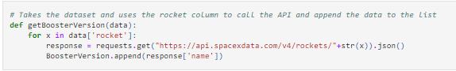
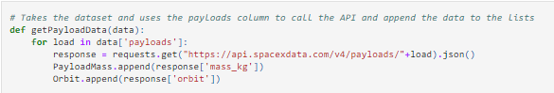
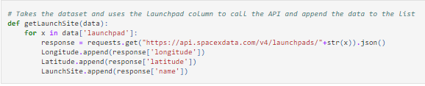
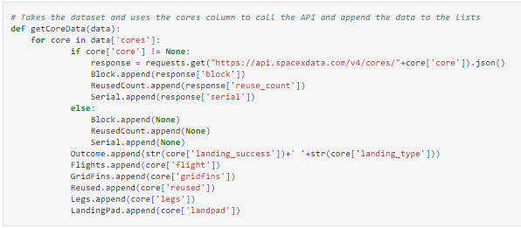
Getting the booster name from the rocket column.
Getting the name of the launch site being used, the logitude, and the latitude from launchpad column.
Getting the mass of the payload and the orbit that it is going to from PayLoadMass column.
Getting the information from cores column
Data Collection – SpaceX API
GitHub Link: Data Collection

Slide 10
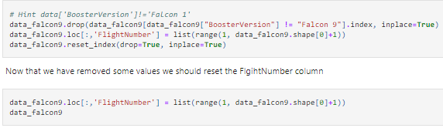
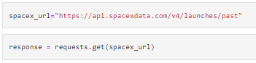
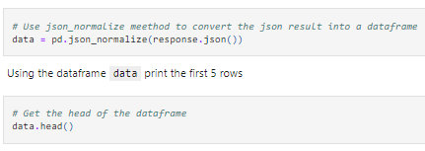
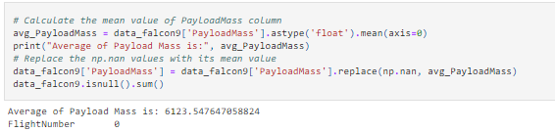
Requesting rocket launch data from SpaceX API
Normalization of the data using .json_normalize
Creating the dataframe using the requested data
Dealing with the missing values
Data Collection – SpaceX API
GitHub Link: Data Collection

Slide 11
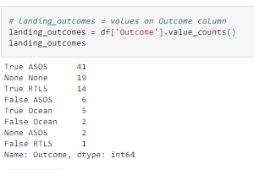
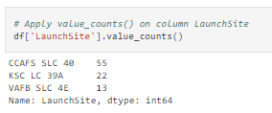
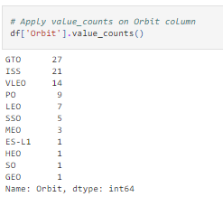
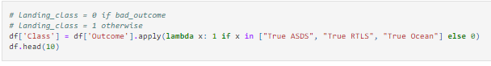
Data Wrangling
Calculating the number of launches on each site
Calculating the number and occurence of mission outcome per orbit type
Creating a landing outcome label from Outcome column
Calculating the number and occurrence of each orbit
GitHub Link: Data Wrangling

Slide 12
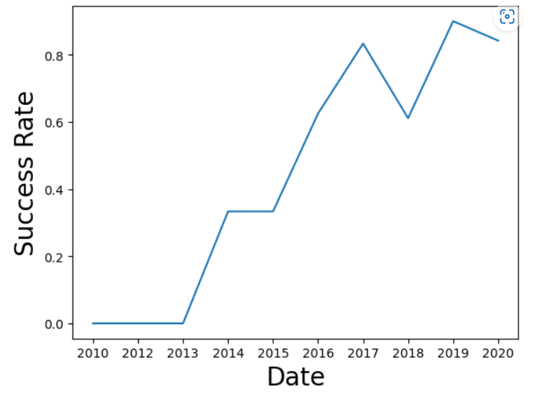
EDA with Data Visualization
In the exploratory data analysis part, we used data visualization skills to visualize the data and extract meaningful patterns to guide the modeling process. The following relationships were examined using scatterplot, bar chart, and line charts.
Flight Number vs. Launch Site
Payload vs. Launch Site
Orbit Type vs. Success Rate
Flight Number vs. Orbit Type
Payload vs. Orbit Type
The Yearly Trend of Launch Success
GitHub Link: EDA with Visualization

Slide 13
EDA with SQL
In the exploratory data analysis with SQL part, we completed;
Displaying the names of the unique launch sites in the space mission,
Listing the five records where launch sites begin with the string "CCA",
Finding the total payload mass carried by boosters launched by NASA (CRS),
Calculating the average payload mass carried by booster version F9 v1.1,
Finding the date when the first successful landing outcome in ground pad was achieved,
Finding the names of the boosters which have success in drone ship and have payload mass greater than 4000 but less than 6000
Listing the total number of successful and failure mission outcomes
Listing the names of the booster versions which have carried the maximum payload mass
Listing the records which will display the month names, failure landing outcomes in drone ship ,booster versions, launch site for the months in year 2015.
Ranking the count of successful landing outcomes between the date 04-06-2010 and 20-03-2017 in descending order.
GitHub Link: EDA with SQL

Slide 14
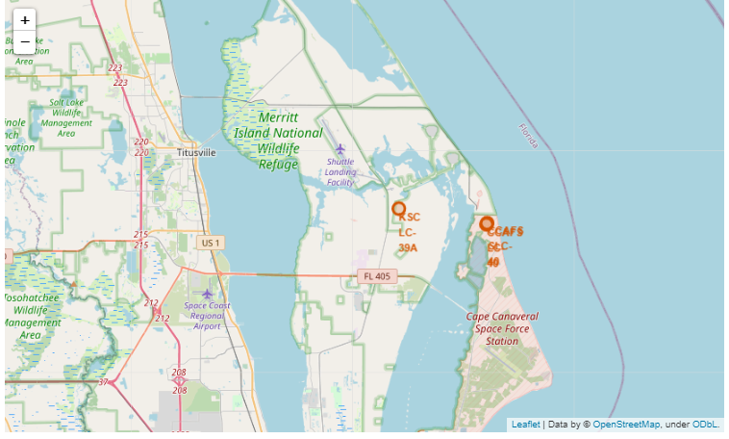
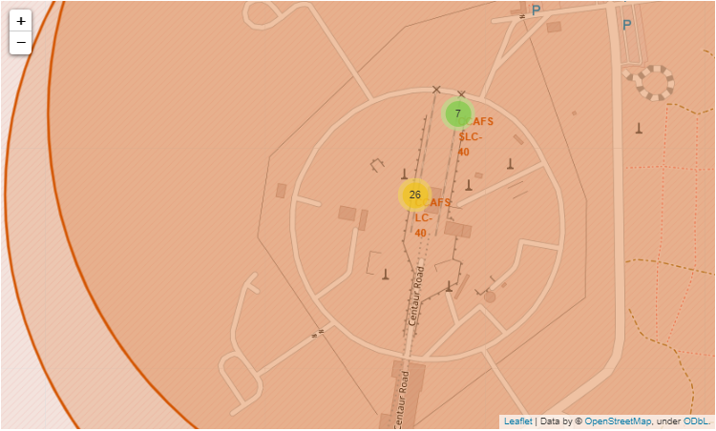
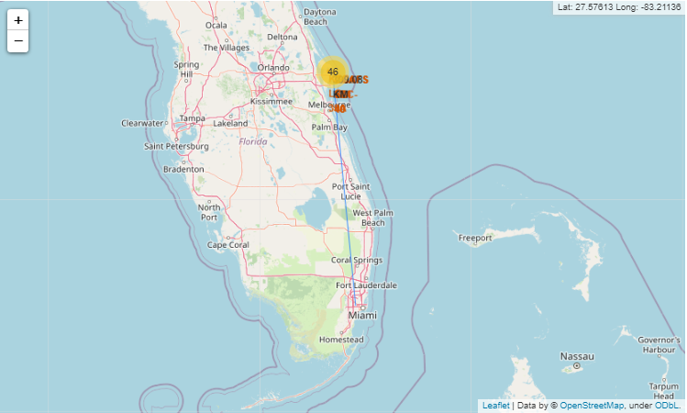
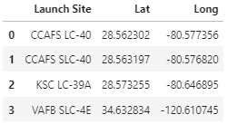
Build an Interactive Map with Folium
Using the Folium lab, we built an interactive map to analyze the launch site proximity.
We marked all the launch sites on the map using the coordinates
We marked the success/failed launches for each site on the map
We calculated the distances between a launch site to its proximities

Slide 15
Predictive Analysis (Classification)
Building The Model
Load and transform the data,
Create test and train data sets
Evaluating The Model
Finding The Best Model
Determine the model with the highest accuracy score
Optimize the parameters for each model using Grid Search
Train the model and perform Grid Search
Calculate the best Hyperparameter for SVM, Classification Trees, and Logistic Regression
Plot the confusion matrix for each model
Check the accuracy for each model
GitHub Link: Machine Learning Prediction

Slide 16
Results
Exploratory data analysis results
Interactive analytics demo in screenshots
Predictive analysis results

Slide 17

Section 2

Slide 18
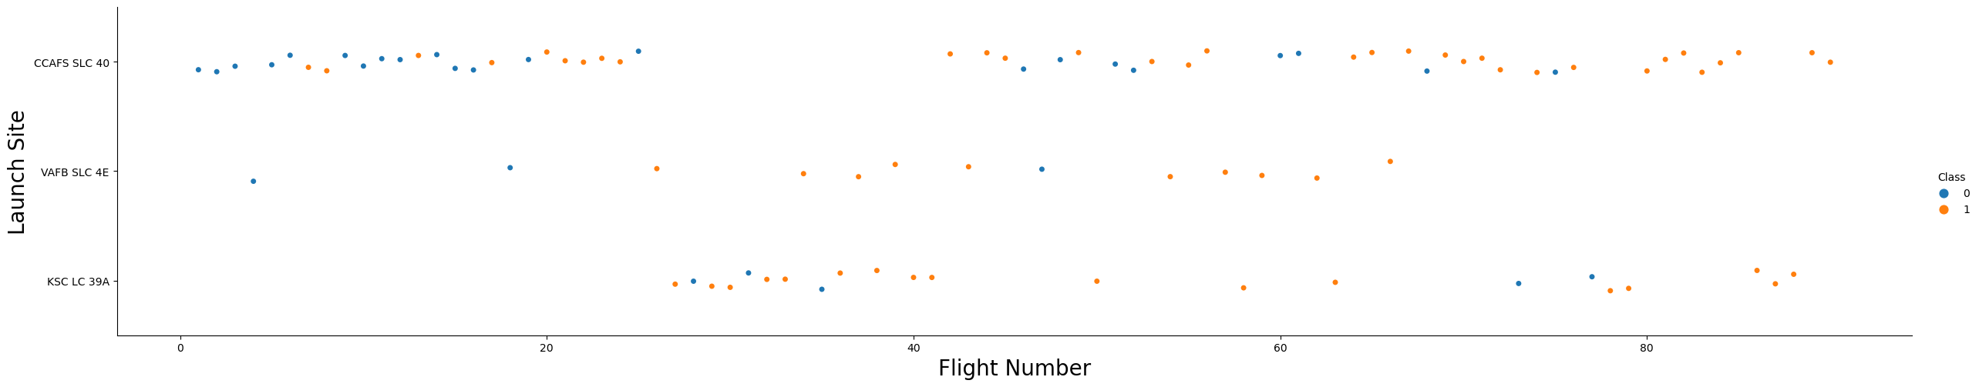
Flight Number vs. Launch Site
Scatter plot of Flight Number vs. Launch Site
The success rate is higher for the recent flights on all launch sites
CCAFS SLC 40 has the lowest success rate

Slide 19
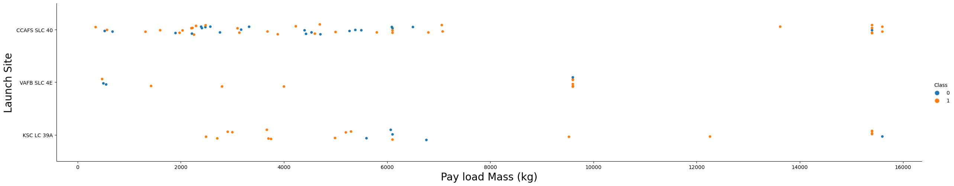
Payload vs. Launch Site
Scatter plot of Payload vs. Launch Site
The success rate increases as the payload mass increases for the launch site VAFB SLC 4E

Slide 20
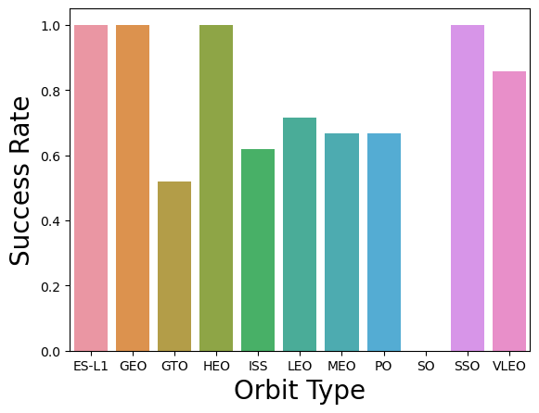
Success Rate vs. Orbit Type
The success rate is higher for the orbit types; ES-L1,GEO,HEO,SSO
The success rate is zero for the orbit type SO

Slide 21
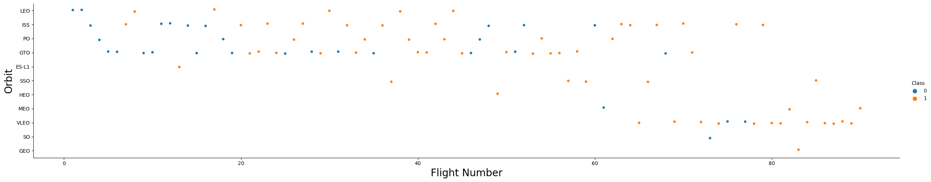
Flight Number vs. Orbit Type
Scatter plot of Flight number vs. Orbit type
The success rate is higher on LEO orbit, as the flight number increases
GTO orbit has no correlation with the flight number
Orbit VLEO has higher rates for higher flight number

Slide 22
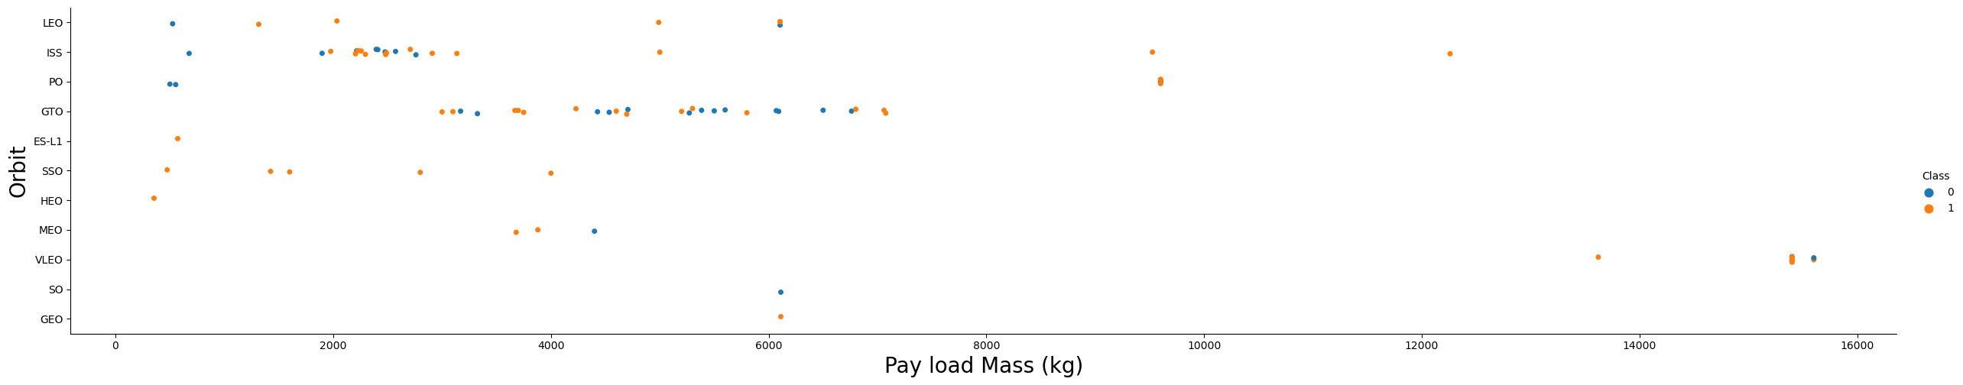
Payload vs. Orbit Type
Scatter plot of payload vs. orbit type
For the orbits PO, LEO, and ISS the success rate is higher for the heavier payloads
Orbit GTO has no correlation with the payload mass

Slide 23
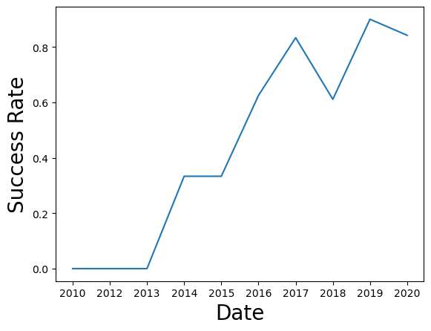
Launch Success Yearly Trend
Line chart of yearly average success rate
The success rate increased between the years 2013 t0 2017
There was a drop in the success rate during the year 2018
There is no successful landing before the year 2013

Slide 24
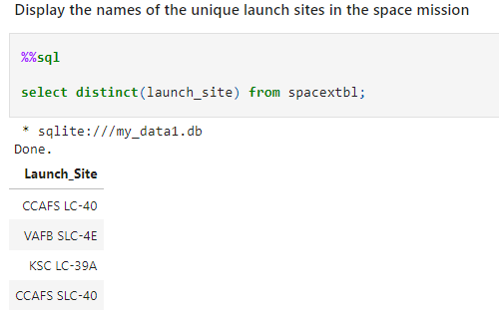
All Launch Site Names
Using SQL to display the unique launch site names

Slide 25
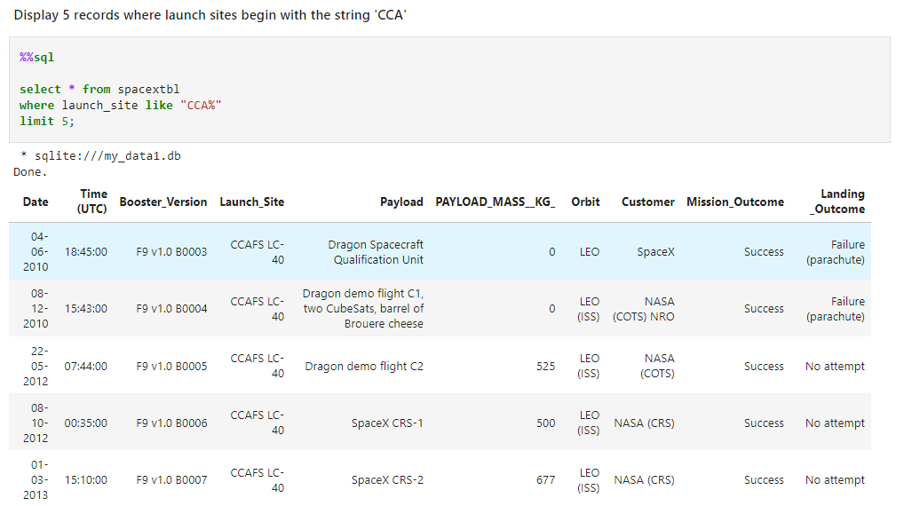
Launch Site Names Begin with 'CCA'
We used "select / where" function form SQL to display the launch sites begin with the string "CCA"

Slide 26
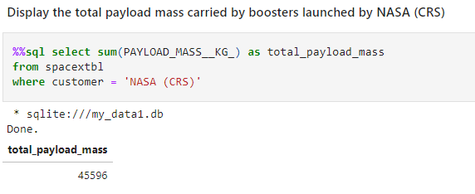
Total Payload Mass
We used "select / sum" function to calculate the total payload mass carried by boosters launched by NASA

Slide 27
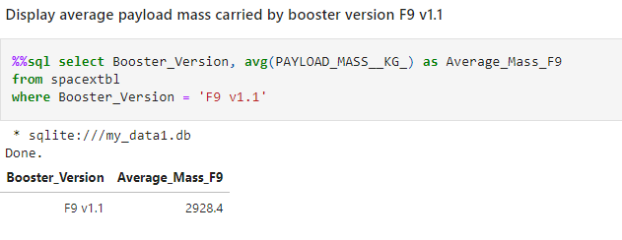
Average Payload Mass by F9 v1.1
Calculating the average payload mass using "select / avg()"

Slide 28
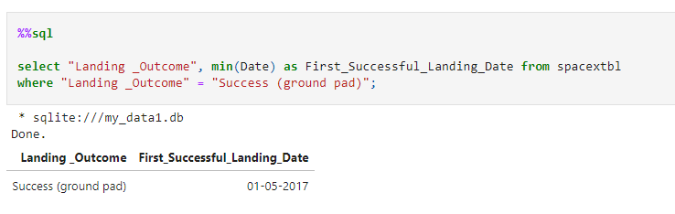
First Successful Ground Landing Date
Finding the dates of the first successful landing outcome on ground pad using the min() function

Slide 29
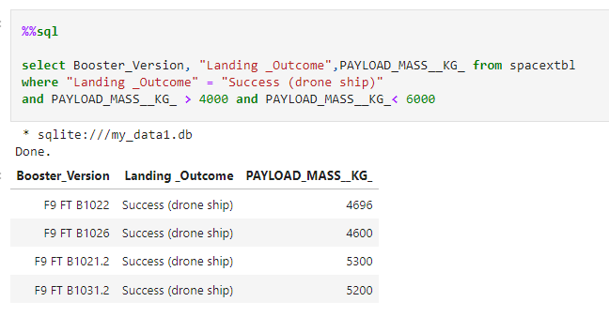
Successful Drone Ship Landing with Payload between 4000 and 6000
We used "select / where / and" function to list the names of boosters which have successfully landed on drone ship and had payload mass greater than 4000 but less than 6000

Slide 30
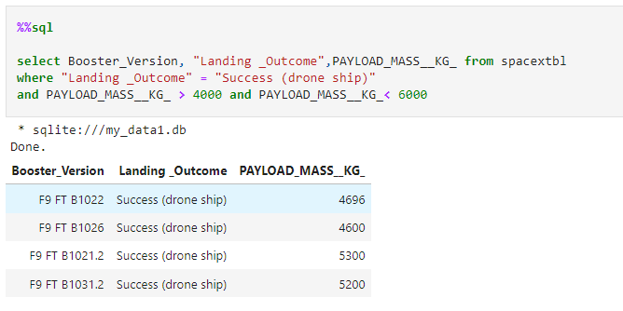
Total Number of Successful and Failure Mission Outcomes
We listed the names of the boosters which have success in drone ship and have the payload mass greater than 4000 but less than 6000

Slide 31
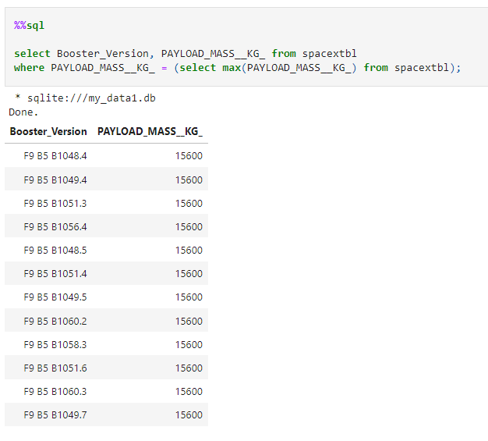
Boosters Carried Maximum Payload
We
We calculated the total number of successful and failure mission outcomes using SQL subquery

Slide 32
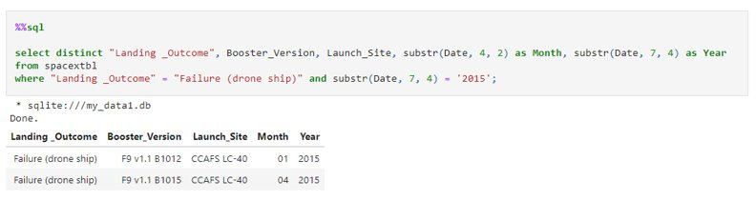
2015 Launch Records
To list the names of the booster which have carried the maximum payload mass, we used the substr(Date, 4, 2) since SQLLite does not support month names.

Slide 33
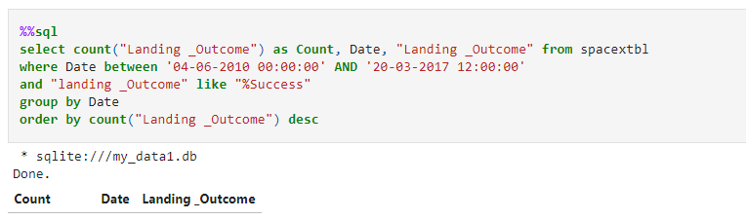
Rank Landing Outcomes Between 2010-06-04 and 2017-03-20
We used the code listed above to rank the count of landing outcomes (such as Failure (drone ship) or Success (ground pad)) between the date 2010-06-04 and 2017-03-20, in descending order

Slide 34

Section 3

Slide 35
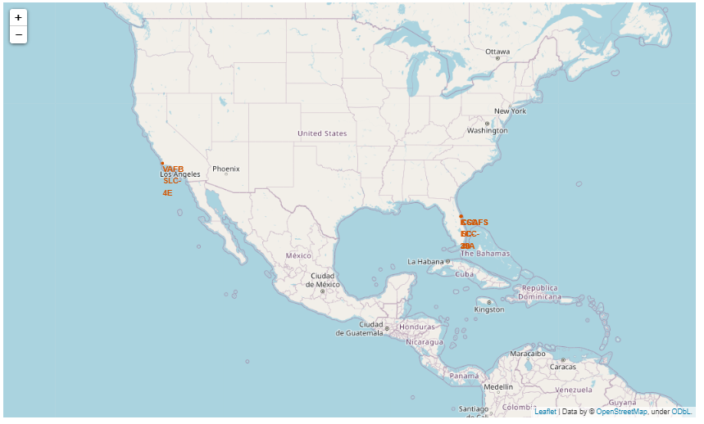
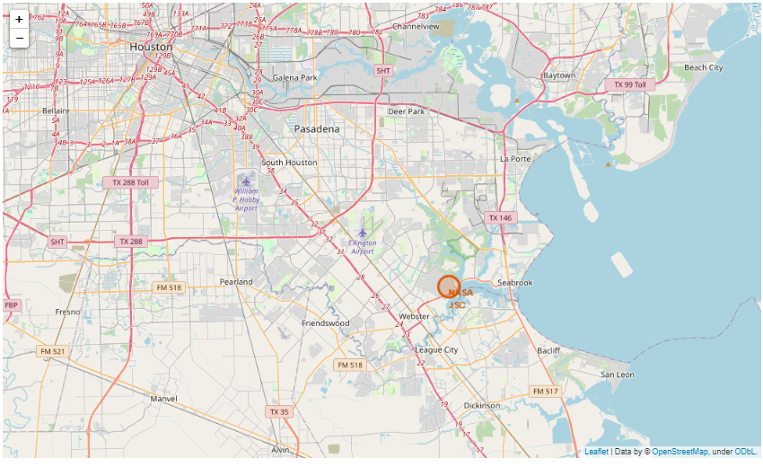
Marking The Launch Sites Using Folium
We used "folium.circle" to add a highlighted circle area with a text label on a specific coordinate.
We added all launch sites on a map.

Slide 36
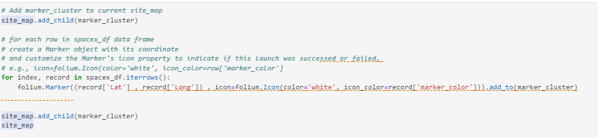
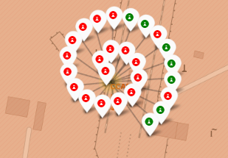
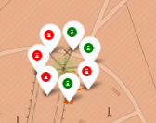
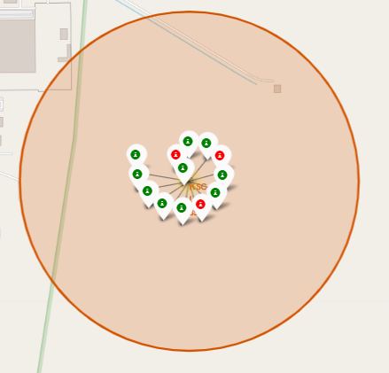
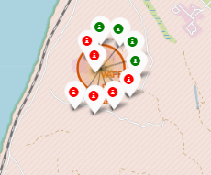
Marking The Success/Failed launches On The Map
We marked all successful landings in green and failed landings in red.
CCAFS LC-40
CCAFS LC-40
KSC LC-39A
VAFB SLC-4E

Slide 37
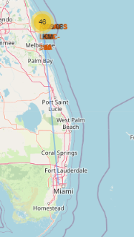
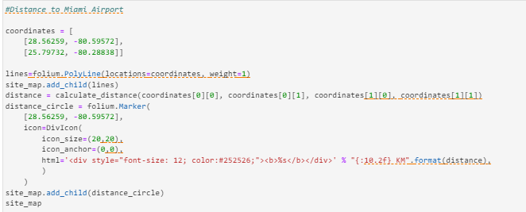
Calculating The Distances Between A Launch Site to Its Proximities
We calculated the distance from the launch site to a chosen point using the folium map.

Slide 38

Section 4

Slide 39
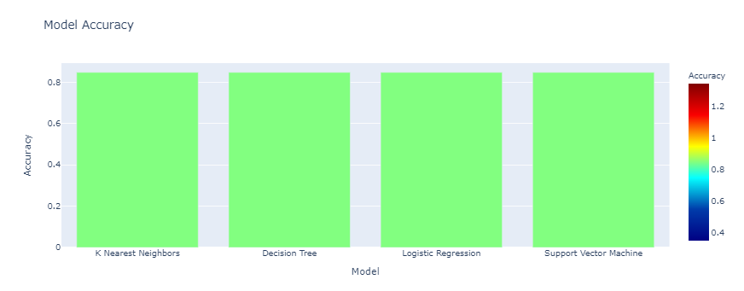
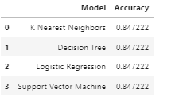
Classification Accuracy
With the selected sample (n=18) the accuracy of the models were the same. If we run the test with a different sample group, the results will be different.
The accuracy rate for all models was 84.7%

Slide 40
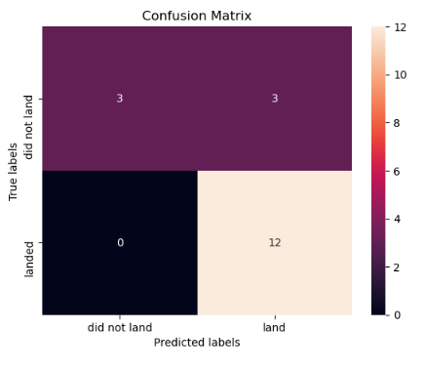
Confusion Matrix
The confusion matrix for all the model types were the same since the accuracy rates were the same.
The models successfully predicted 84.7% of the landings.

Slide 41
Appendix
The GitHub Link for the Project

Slide 42
Conclusions
The success rate of SpaceX has been increasing over the time.
The success rates are higher for the orbits; ES-L1, GEO, HEO, and SSO.
KSC LC-39A has a higher success rate.
All four of the models successfully predicted 84.7% of the landing cases.

Slide 43


